Slide 1


Final Presentation: On the Web Listing (OWL) Marketplace
By Philip Canzian, Jose Casiano, and Forrest Moulin (Group 7)
Pennsylvania State University
College of Information Sciences and Technology
IST 440W - Integration and Problem Solving
Summer 2022

Slide 2
Presentation Overview
1) Introduction, Problem Statement, Motivation, Application
2) Stakeholder Analysis
3) Operational Flow Chart
4) Technical Flow Chart
5) Gantt Chart and Timeline
6) Implementation and Demo
7) Final Discussion
8) References

Slide 3

Introduction
Background:
COVID-19 Pandemic
Online Shopping Movement
Project Overview:
To enhance a Property Listing Application
Focus on User Experience
“In 2020 over 60% of homebuyers made an offer on a residence they’d never visited”

Slide 4
Problem Statement
Online shopping trend has been on the rise through the years. However, with the pandemic this long-term trend has increased exponentially, thus creating an opening for the virtual property marketplace.
97% of homebuyers use the internet to research properties when looking for new homes (Investopedia 2021)

Slide 5
Motivation
Benefits
Increase in ease of use and comfort
COVID-19 pandemic
Target the largest demographic of consumers
Increasing sales within the housing industry.

Slide 6
Application
Phase 1: Back End
Phase 2: Database
Phase 3: APIs
Phase 4: Front End
Phase 5: Working Applications and Future Enhancements

Slide 7
Stakeholder Analysis
The Online Property Listing Application has six important stakeholders:
Stakeholders | Power | Interest | Legitimacy
Homebuyers | 3 | 9 | 7
Homeowners | 4 | 9 | 8
Renters | 3 | 9 | 7
Realtors and Real Estate Agencies | 6 | 10 | 9
Property Investors/House Flippers | 6 | 9 | 8
Shareholders | 7 | 9 | 9

Slide 8
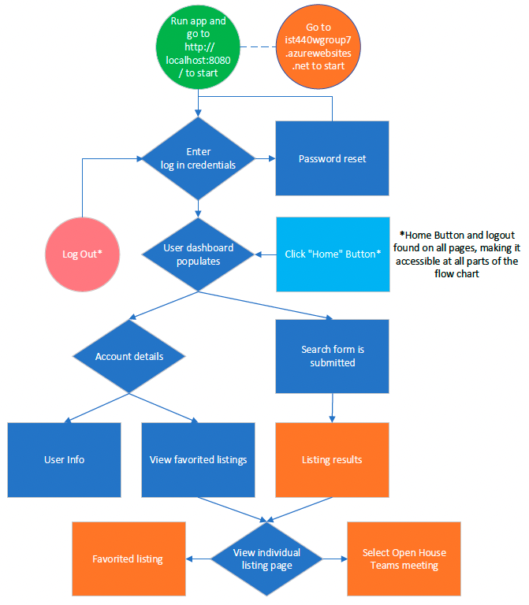
Operational Flow Chart

Slide 9
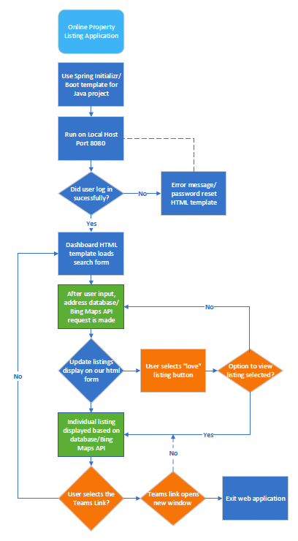
Technical Flow Chart

Slide 10
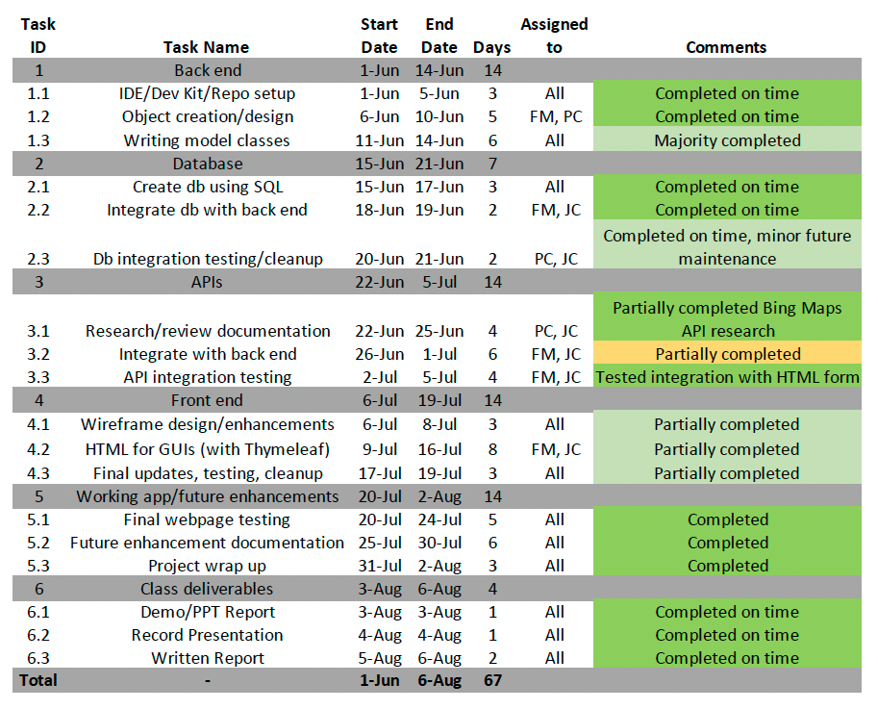
Gantt Chart
Notes:
Philip
This is our Gantt chart. We developed a basic blue print of our planning

Slide 11
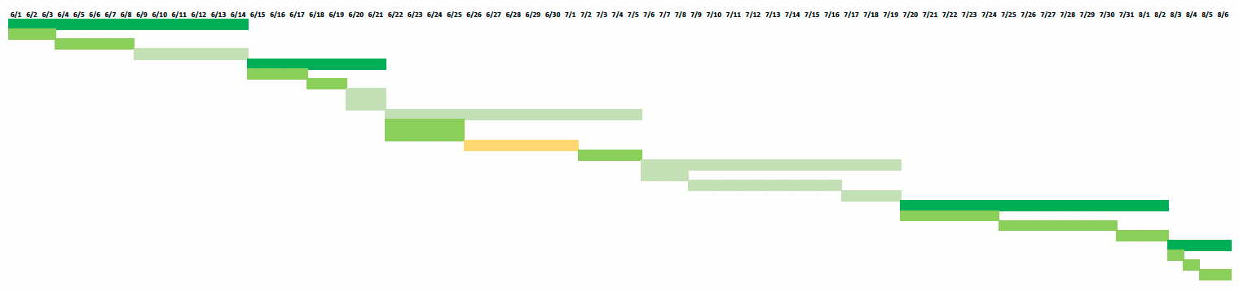
Gantt Chart Timeline
Notes:
Philip

Slide 12
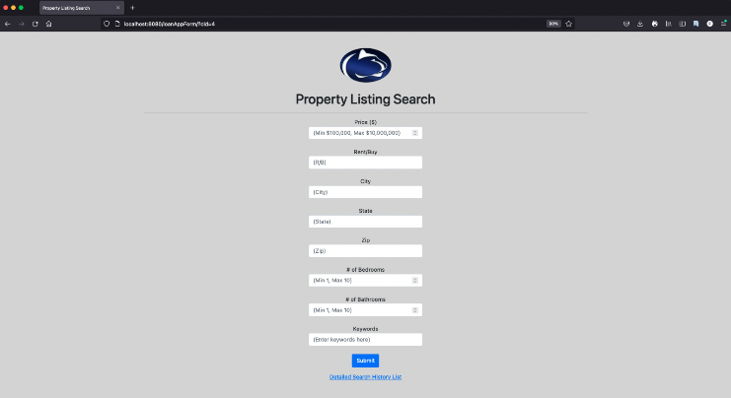
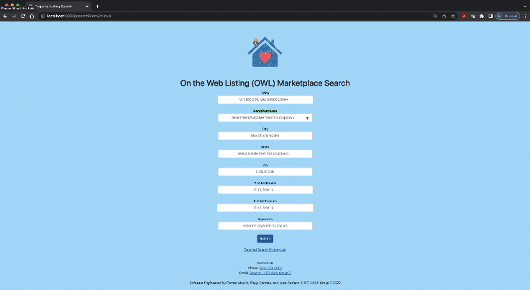
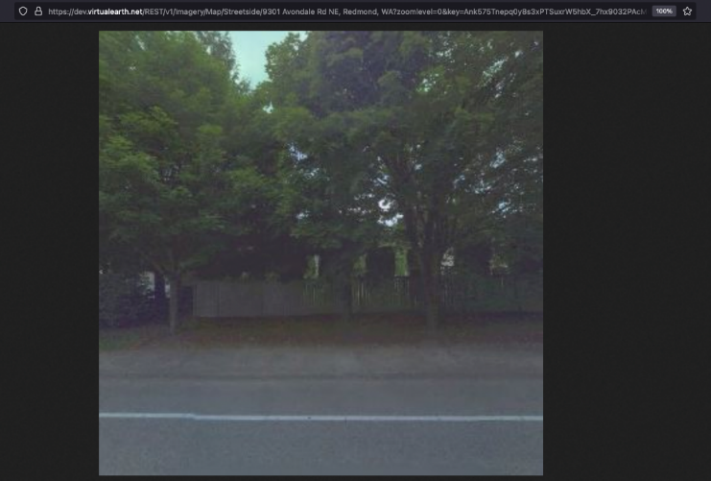
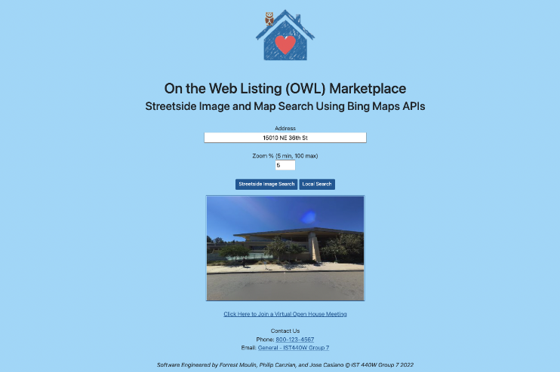
Final Discussion
Setting up GitHub repository
Implementing a cloud-based database
Virtual project collaboration
Managing time zone differences
Flexibility of platform and API utilization

Slide 13
Future Work
Microsoft Graph API for Teams integration
Search results functionality
Hosting the app on Azure App Service
UI enhancements/mobile compatibility
Additional use cases

Slide 14
References
MySQL Documentation. MySQL. (n.d.). Retrieved June 24, 2022, from https://dev.mysql.com/doc/
Nkramer. (2022, March 28). Microsoft Teams API Overview - Microsoft Graph. Microsoft Graph | Microsoft Docs. Retrieved June 20, 2022, from https://docs.microsoft.com/en-us/graph/teams-concept-overview
Rbrundritt. (2018, December 14). Locations API - Bing Maps. Locations API - Bing Maps | Microsoft Docs. Retrieved June 15, 2022, from https://docs.microsoft.com/en-us/bingmaps/rest-services/locations/
Segal, T. (2022, March 1). How COVID-19 changed consumer shopping behavior. Investopedia. Retrieved May 28, 2022, from https://www.investopedia.com/how-we-shop-now-5184434
Spring Data JPA. Spring. (n.d.). Retrieved June 24, 2022, from https://spring.io/projects/spring-data-jpa
Thymeleaf. (n.d.). Retrieved May 31, 2022, from https://www.thymeleaf.org/doc/articles/standarddialect5minutes.html
Thymeleaf. (n.d.). Tutorial: Using Thymeleaf. Retrieved June 24, 2022, from https://www.thymeleaf.org/doc/tutorials/3.0/usingthymeleaf.html

